Slide 1
yt_geotiff: a geoscience extension for YT
Dan Eastwood and Britton Smith

Slide 2
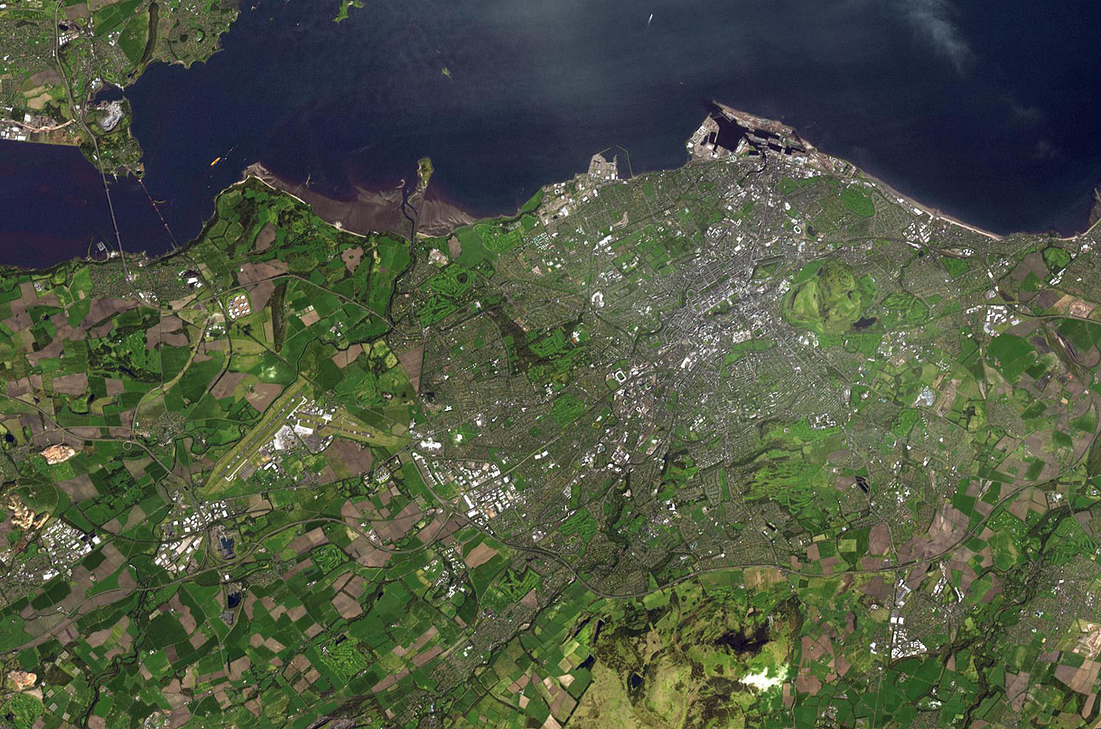
Outline
What is the project?
Background
Remote sensor imaging
Geoscience data
Aims of the project
Progress so far…
Future work

Slide 3
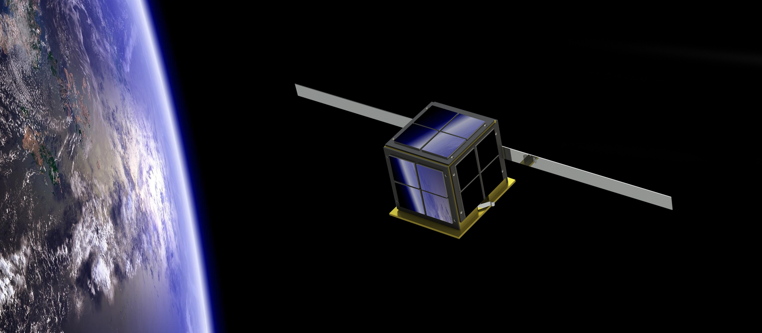

The project
Working with mirco-satellite design and manufacturing company ALBA ORBITAL
Building a data-pipeline for handling image data from future satellites

Slide 4
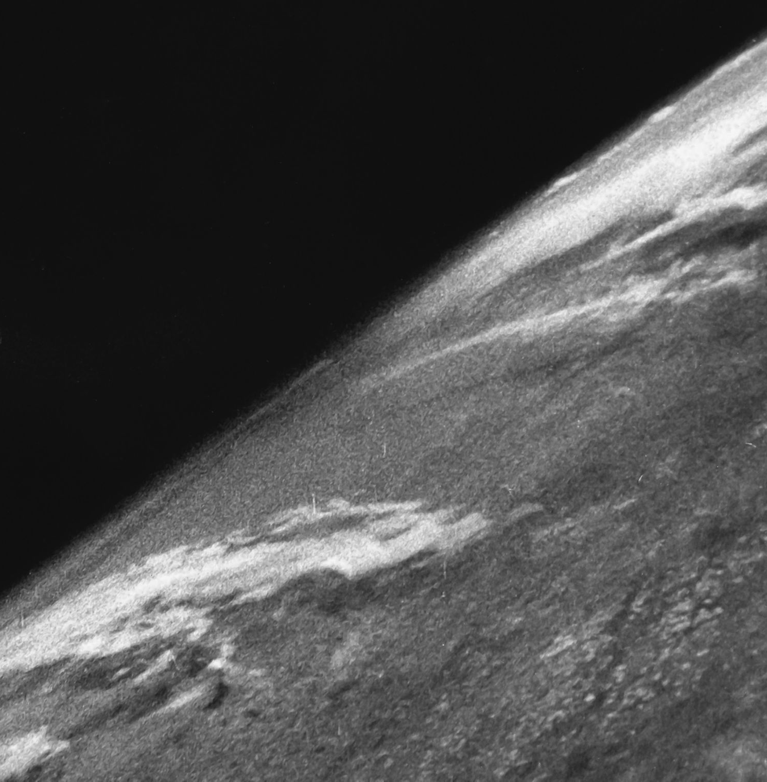
Background: Satellite Imaging
First images taken from space on sub-orbital V2 rocket flights in 1946
Imaging used in a variety of fields from weather to defence
… and now anyone can do it!
Notes:
meteorology, oceanography, fishing, agriculture, biodiversity conservation, forestry, landscape, geology, cartography, regional planning, education, intelligence and warfare

Slide 5
Image data
Primarily the focus is on raster data with georeferencing
Multiband images prefered
Also data points or points clouds are used

Slide 6
The aims of the project
Develop a python extension for yt to handle geotiff data file formats
Deal with both single- and multi-band images
Read and write these files

Slide 7
Progress so far…
Identified existing libraries for handling geotiff and other raster file formats
Implemented a yt.load function for geotiff files that should work for both single and multiband files
Plotted an image ..!

Slide 8
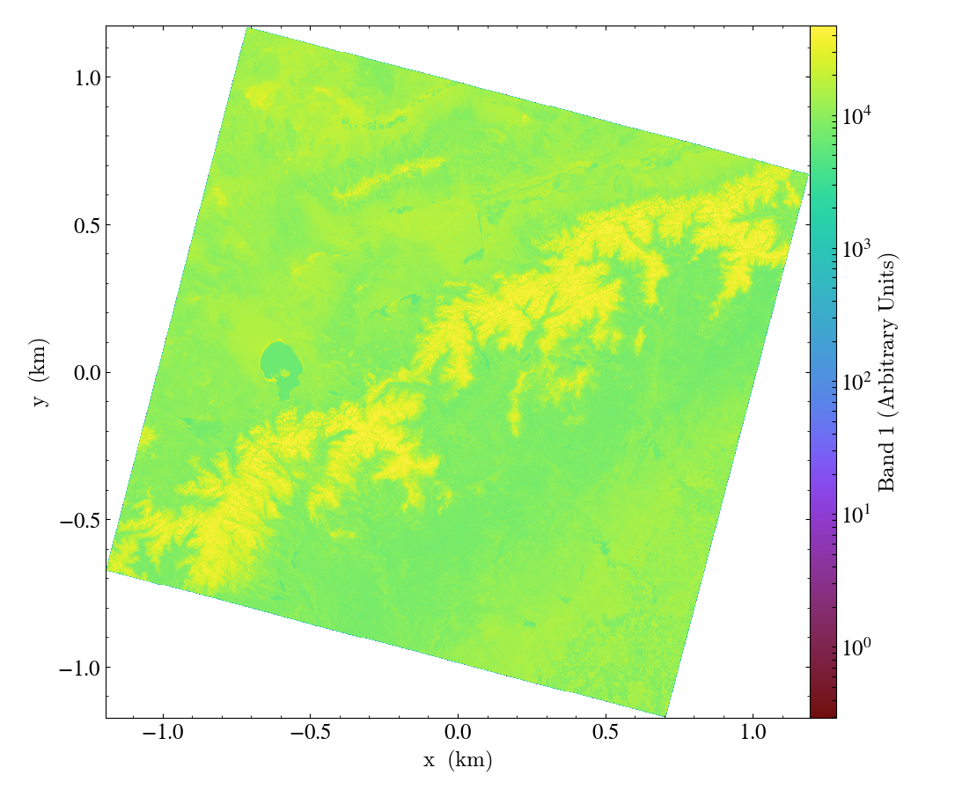

Slide 9
Future work
Implement the capability for yt_geotiff to read and write both multi- and single-band files
Document
Create jupyter notebooks for testing/examples

